Slide 1
Week 8: Linear Processing Filtering
(I’m Fun) Digital Image Fundamentals
Thuong Nguyen Canh
Institute for Datability Science, Osaka University
November 2019
This material is based on the Digital Image Processing, Stanford University, Prof. Bernd Girod.

Slide 2
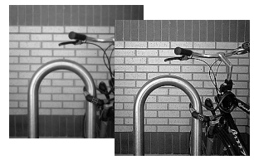
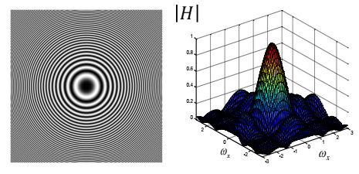
Contents
2D Linear systems
Separability
Shift-Invariant Linear System
Integral Image for fast box-filtering
2D Frequency response
Blurring and Sharpening
Zoneplate
Image sampling/aliasing
Wiener filtering
Nonlinear noise reduction/sharpening

Slide 3
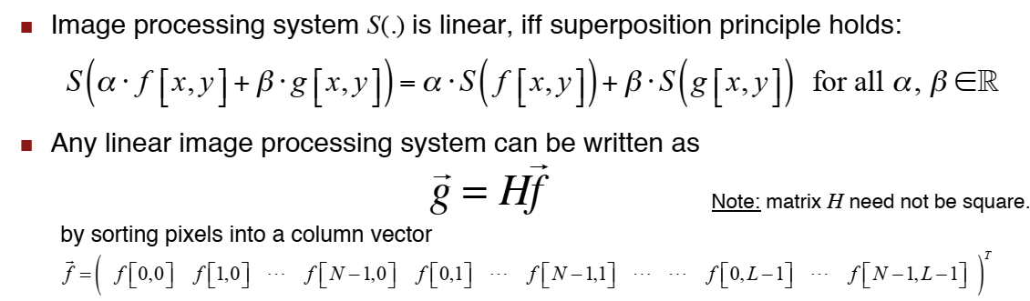
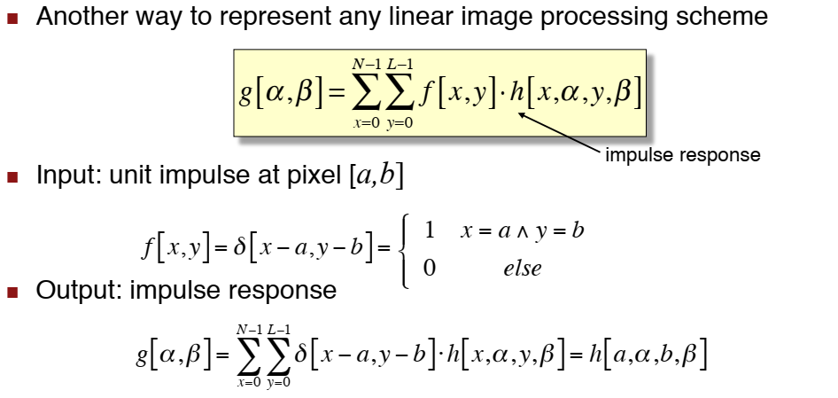
Linear Image Processing (1)
Impulse
response
(Đáp ứng xung)
https://vi.wikipedia.org/wiki/%C4%90%C3%A1p_%E1%BB%A9ng_xung
Notes:
Morphological image processing is a collection of non-linear operations related to the shape or morphology of features in an image.

Slide 4
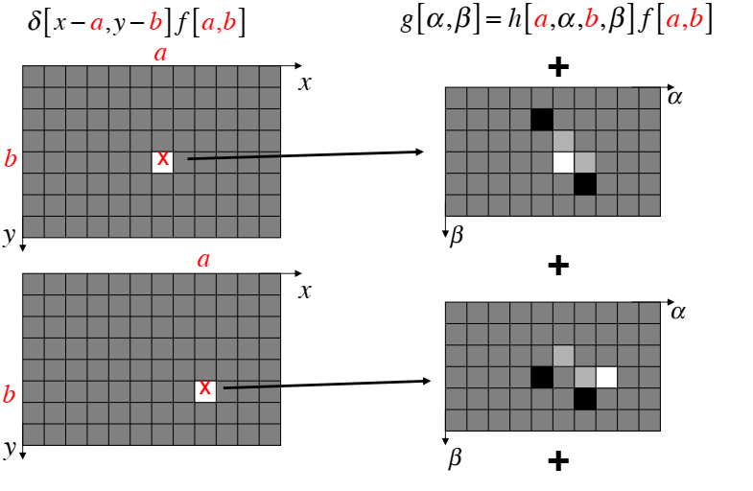
Linear Image Processing (2)
#1: Superposition of impulse responses

Slide 5
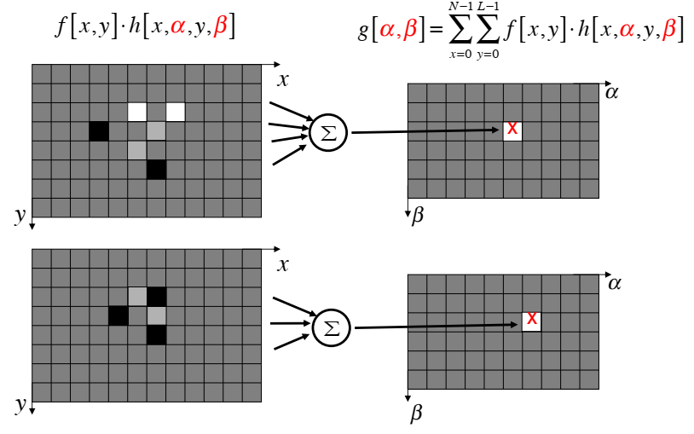
Linear Image Processing (3)
#2: Linear combination of input values

Slide 6
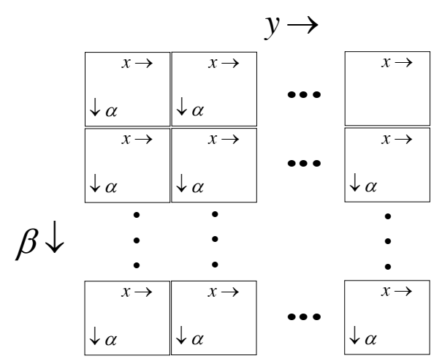
Linear Image Processing (4)
Relationship of H and h[x, α, y, β]

Slide 7
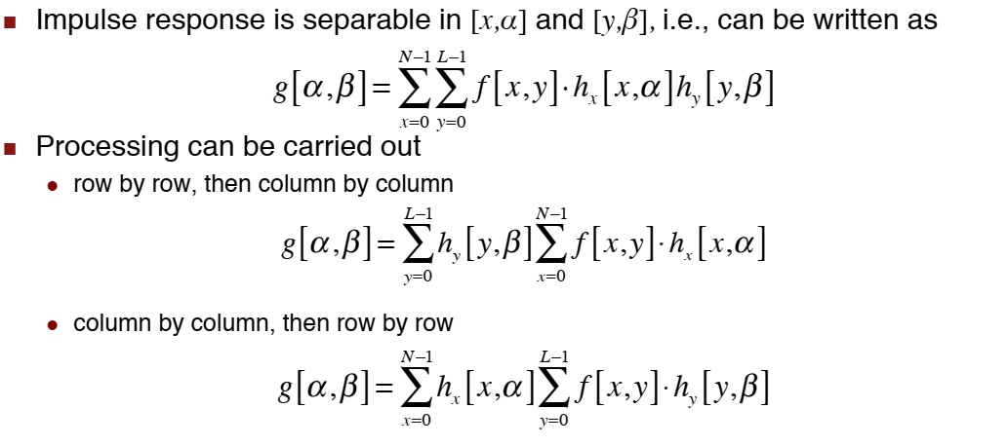
Separable Linear Image Process. (1)

Slide 8
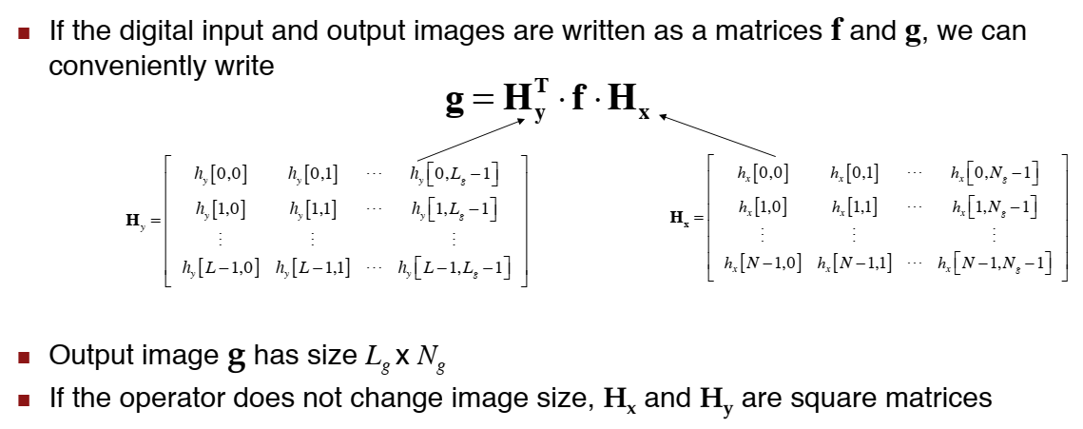
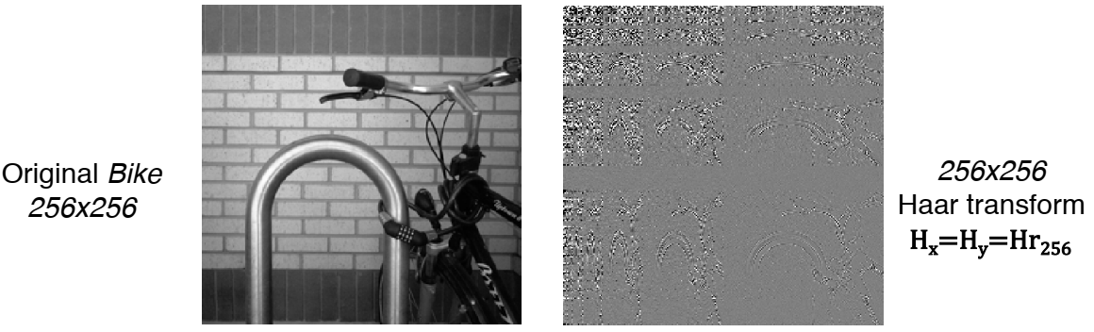
Separable Linear Image Process. (1)
Example

Slide 9
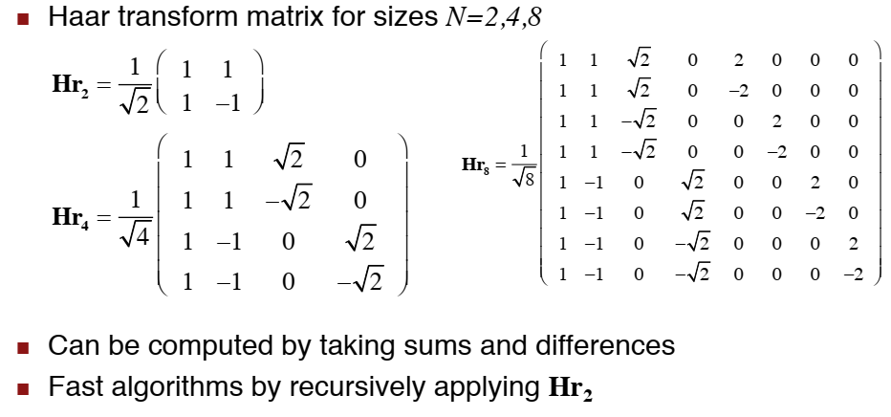
Haar Transform

Slide 10
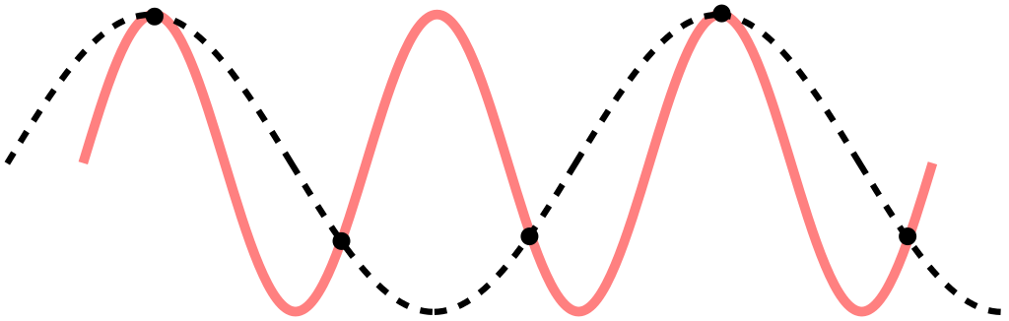
Sampling (1)
Nyquist sampling theorem
Aliasing
An effect that causes different signals to become indistinguishable (or aliases of one another) when sampled

Slide 11
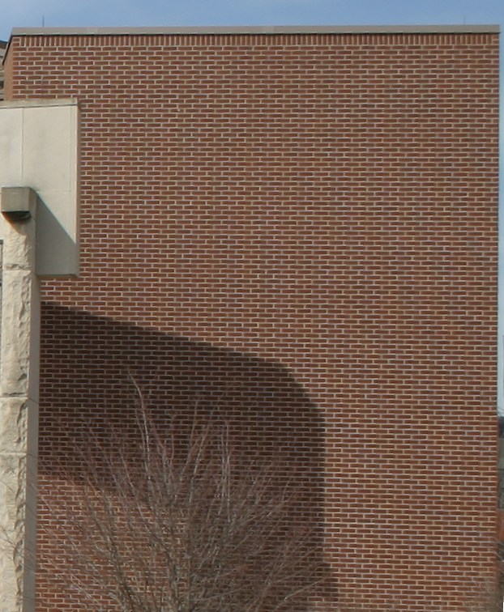
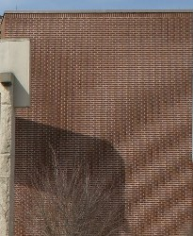
Sampling (2)
properly sampled image
Under-sampled image

Slide 12
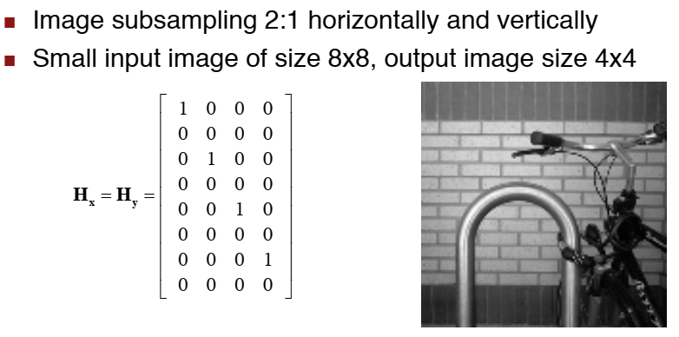
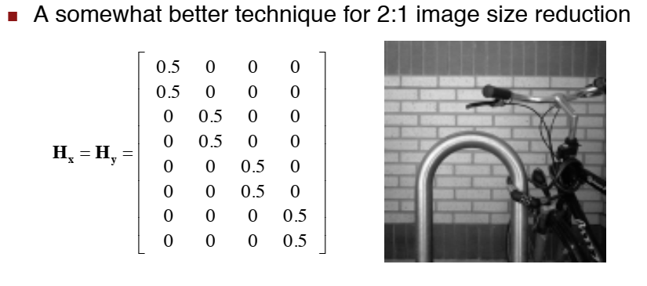
Sub-sampling (1)
A1
A2

Slide 13
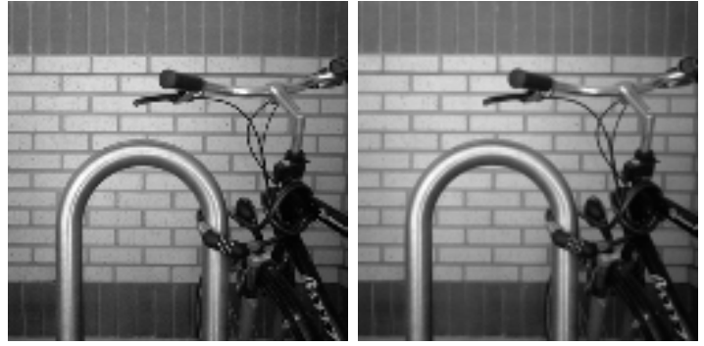
Subsampling (2)
A1
A2

Slide 14
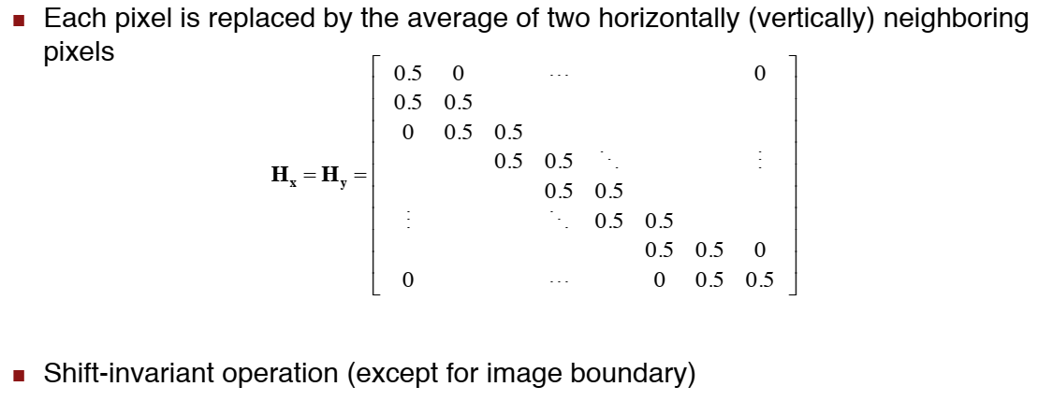
Another Example

Slide 15
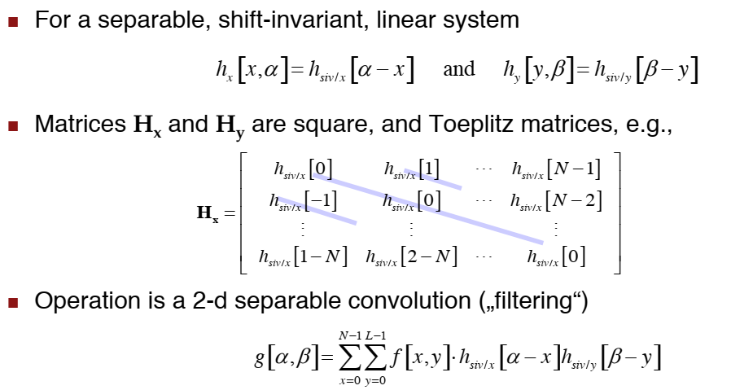
Shift-Invariant System & Toeplitz Matrices

Slide 16
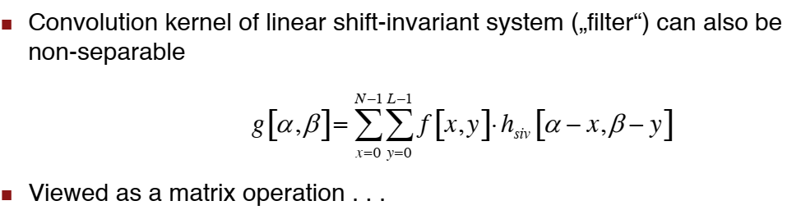
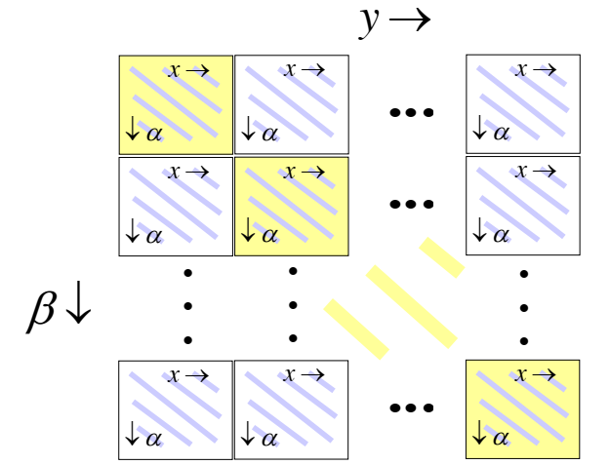
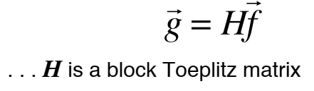
Non-Separable 2D Convolution

Slide 17
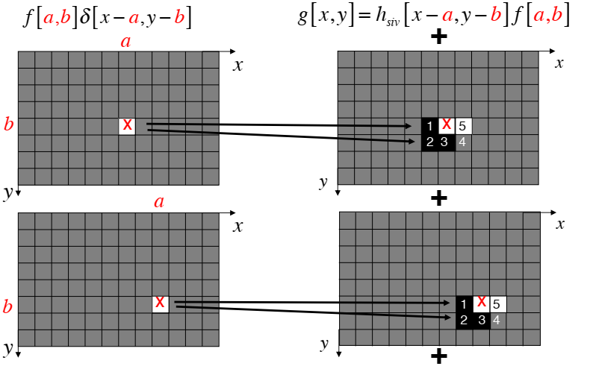
Non-Separable 2D Convolution
#1 Superposition of impulse response

Slide 18
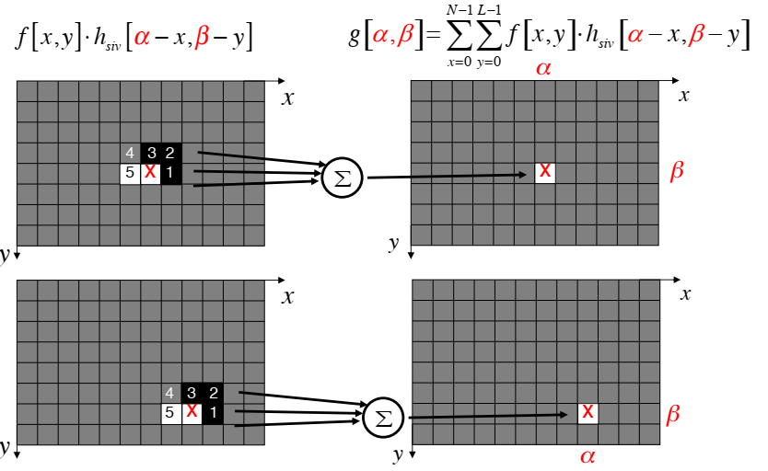
Non-Separable 2D Convolution
#2 Linear combination of neighboring pixel values

Slide 19
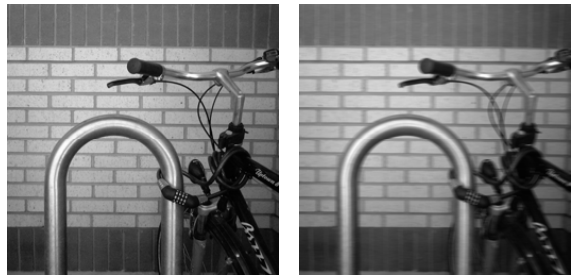
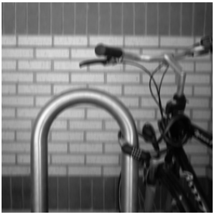
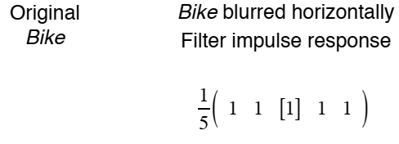
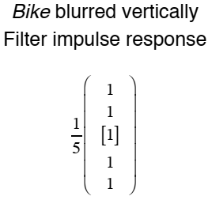
Convolution Example

Slide 20
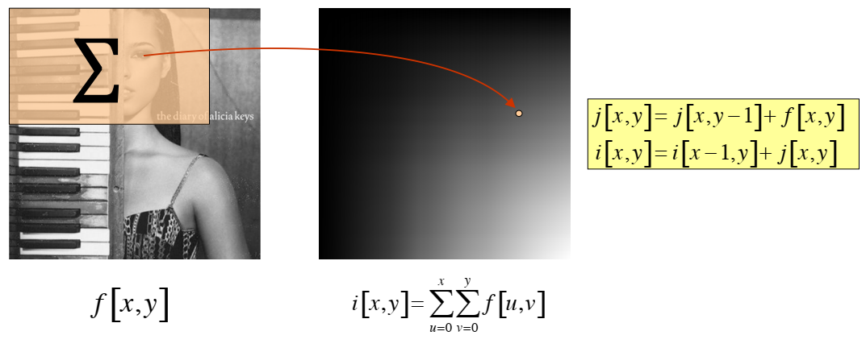
Integral Image
Derived via cumulative addition of intensity pixels in both horizontal & vertical
Image processing often process on a local region of images

Slide 21
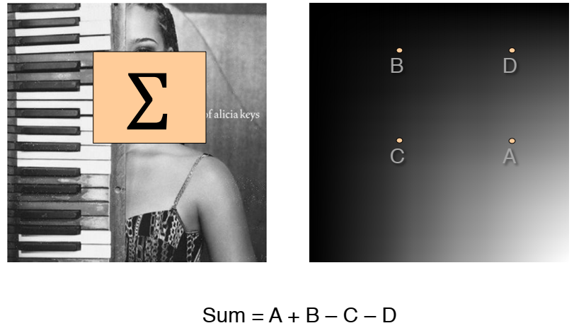
Box Filtering
An average-of-surrounding-pixel kind of image filtering.

Slide 22
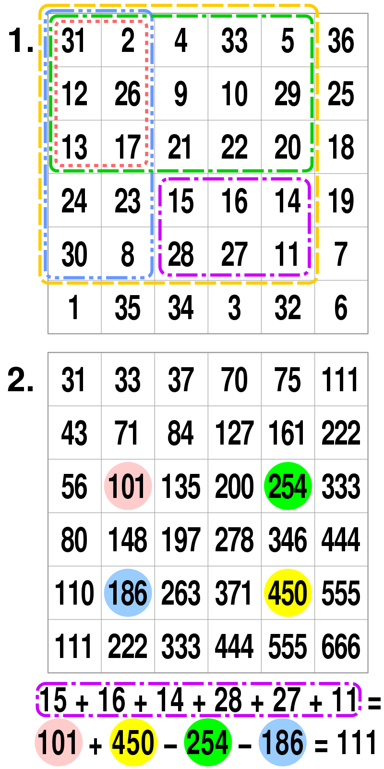
Box filtering
Example

Slide 23
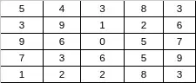
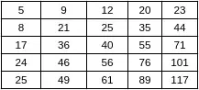
Why integral image
Summed-area table
Faster and less computation for large input size images
Normal Average: 9 operations
9 + 1 + 2 + 6 + 0 + 5 + 3 + 6 + 5 = 37
37/9 = 4.11
→ 100 average requires 100*09 = 900 operations
56 operations
Integral image
Integral image: 4 operations
(76 - 20) - (24 - 5) = 37
37 / 9 = 4.11
→ 100 operation requires 56 + 100*9 = 456 operations
https://www.quora.com/How-integral-image-is-used-in-image-processing-and-how-improves-the-computation-time

Slide 24
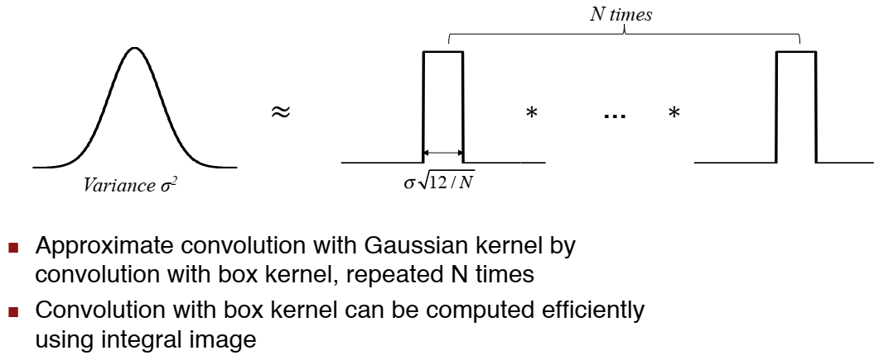
Gaussian Filtering by Repeated Box Filter

Slide 25
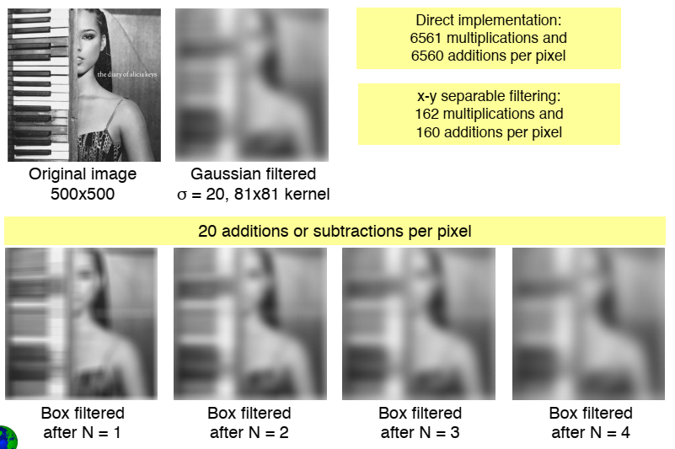
Gaussian Filtering by Repeated Box Filter

Slide 26
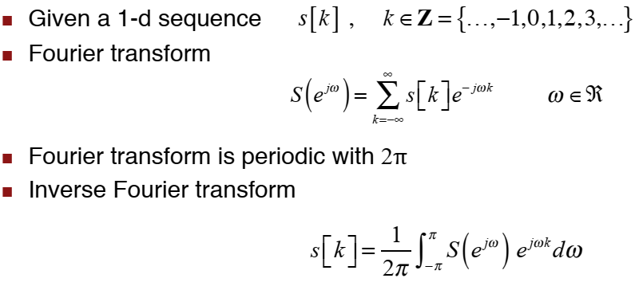
1D Discrete-Time Fourier Transform

Slide 27
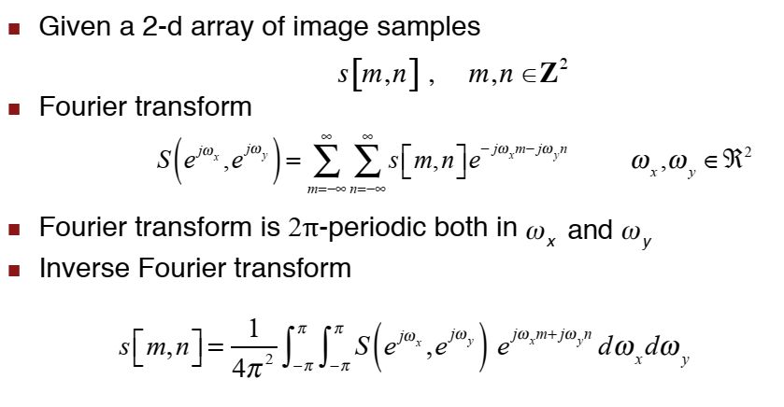
2D Discrete-Time Fourier Transform

Slide 28
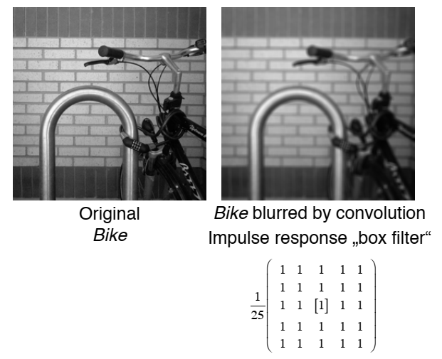
5x5 Box Filter Revisited

Slide 29
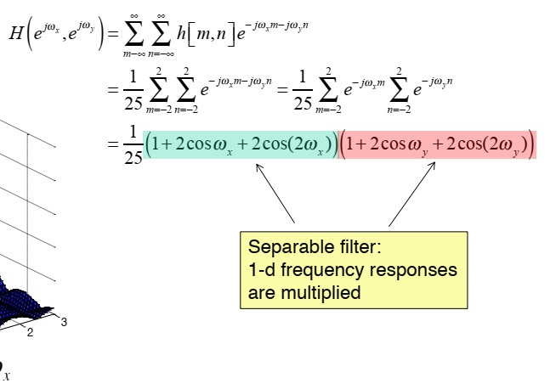
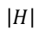
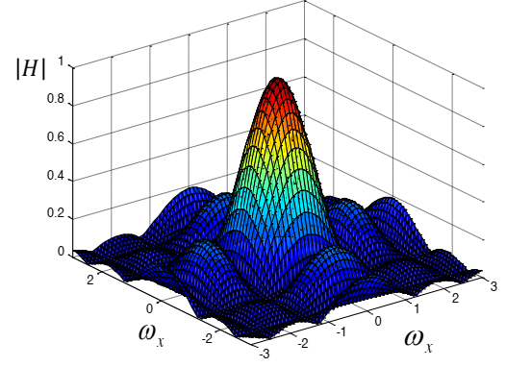
Frequency Response

Slide 30
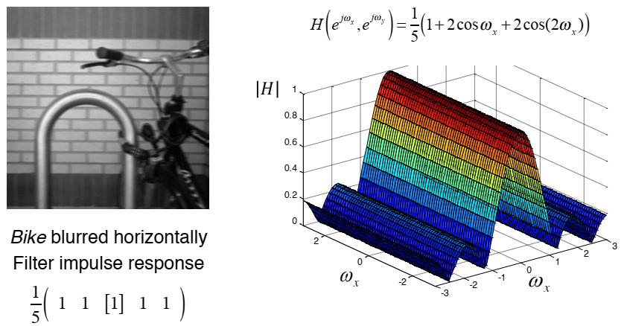
Horizontal Lowpass Filter

Slide 31
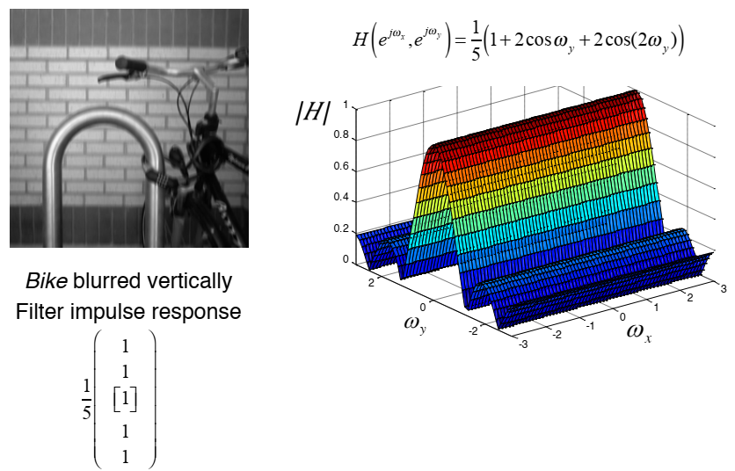
Vertical Lowpass Filter

Slide 32
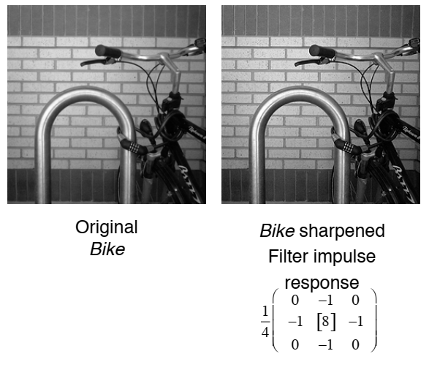
Sharping Filter

Slide 33
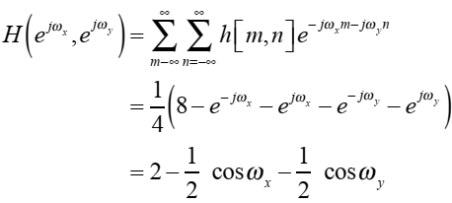
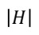
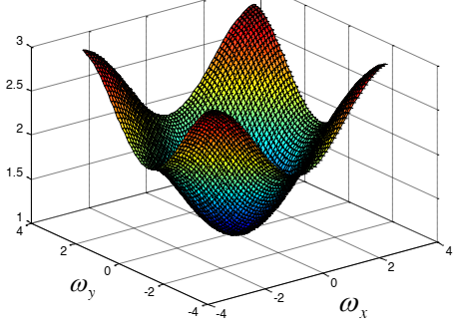
Sharping Filter (2)
Frequency response

Slide 34
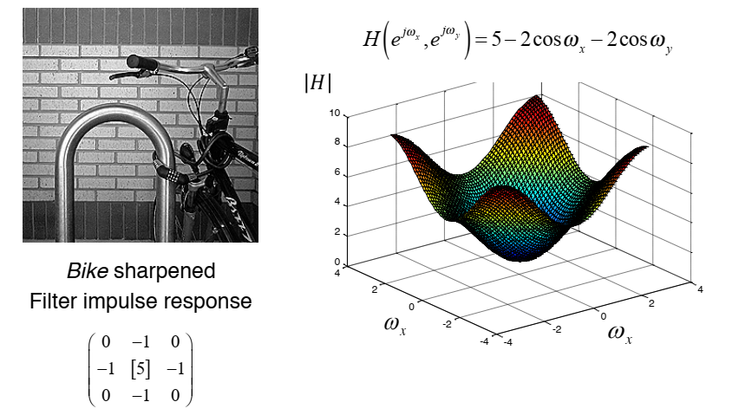
Sharping Filter (3)
More aggressive sharpening filter

Slide 35
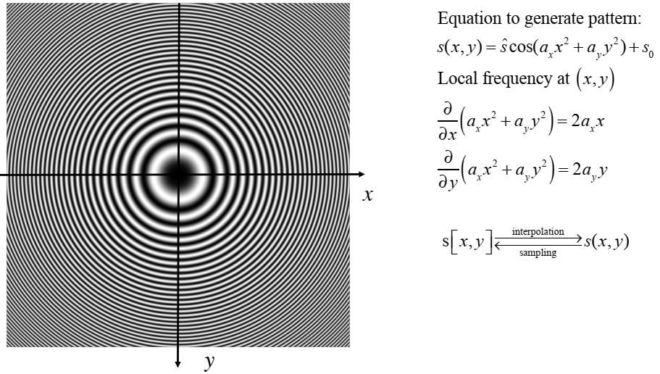
Zoneplate pattern
Used to visualize the frequency plane

Slide 36
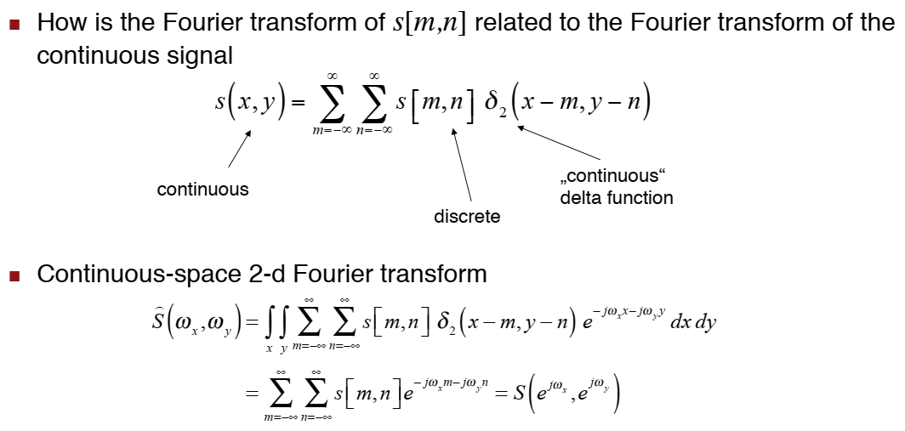
Sampling interpretation of 2D FT

Slide 37

Lowpass filtering

Slide 38



Zoneplate demonstration

Slide 39

Subsampling with prefiltering
Horizontal/Vertical 2:1 subsampling

Slide 40


Image magnification (10%)

Slide 41


Optical Anti-Aliasing filter
An anti-aliasing filter (AAF) is a filter used before a signal sampler to restrict the bandwidth of a signal

Slide 42



Blurry images

Slide 43

Blurry Images

Slide 44





Image Restoration
Recover the original image x from its degraded version y
H is an identity matrix → Image denoising
H is a convolution matrix → image deconvolution/deblurring
H is a sampling matrix with size mxn, m<<n, → Compressive sensing recovery
H is a downsampling matrix → image super-resolution
H is a selection matrix → Image inpainting
$$y=Hx+n$$
Denoise
Deblur/deconv.
CS/SuperRes
Inpainting

Slide 45

Image Deconvolution

Slide 46

Image Deconvolution
Naïve approach

Slide 47

Wiener Filtering

Slide 48

Review: Power spectrum & Cross spectrum

Slide 49

Wiener Filter (2)

Slide 50

Wiener filter for linear distortion and additive noise

Slide 51

Wiener filter for linear distortion and additive noise

Slide 52

Wiener filter for additive noise

Slide 53

Wiener filter for additive noise

Slide 54

Nonlinear noise reduction/sharpening

Slide 55

Nonlinear noise reduction/sharpening

Slide 56

Nonlinear noise reduction/sharpening

Slide 57

Highpass filtered images

Slide 58

Soft scoring function

Slide 59

Soft scoring of highpass filtered images

Slide 60

Linear vs. nonlinear noise reduction/sharpening

Slide 61
Reference
Video Lecture on “Introduction to Linear Image Processing,”
Iasonas Kokkinos
http://www.ipam.ucla.edu/abstract/?tid=11321&pcode=GSS2013

